Slide 1
Real Options Theory in Strategic Management
Lenos Trigeorgis & Jeffrey J. Reuer (2017)
Strategic management journal

Slide 2
Main Purpose
Provide a critical review and synthesis of real options theory in strategic management research
Consider the potential for extending real options theory to address the fundamental issues of strategy
Suggest the novel research opportunities through better integration of the three main approaches: real options reasoning, real options modeling, and behavioral perspectives on real options

Slide 3
Fundamentals of Real Options Theory
Real Options
Real:
Opportunities to purchase real assets (tangible or intangible) on possibly favorable terms
These favorable terms hinge on adjustment costs, market power, or other imperfections in product or factor markets.
Options:
An option is a right, but not an obligation, to take some future specified action at a specified cost.
Fundamental decision asymmetry to take a future decision (e.g., invest) only if it’s beneficial to the decision maker.
→ Gives rise to an asymmetry in firm outcomes in the presence of uncertainty

Slide 4
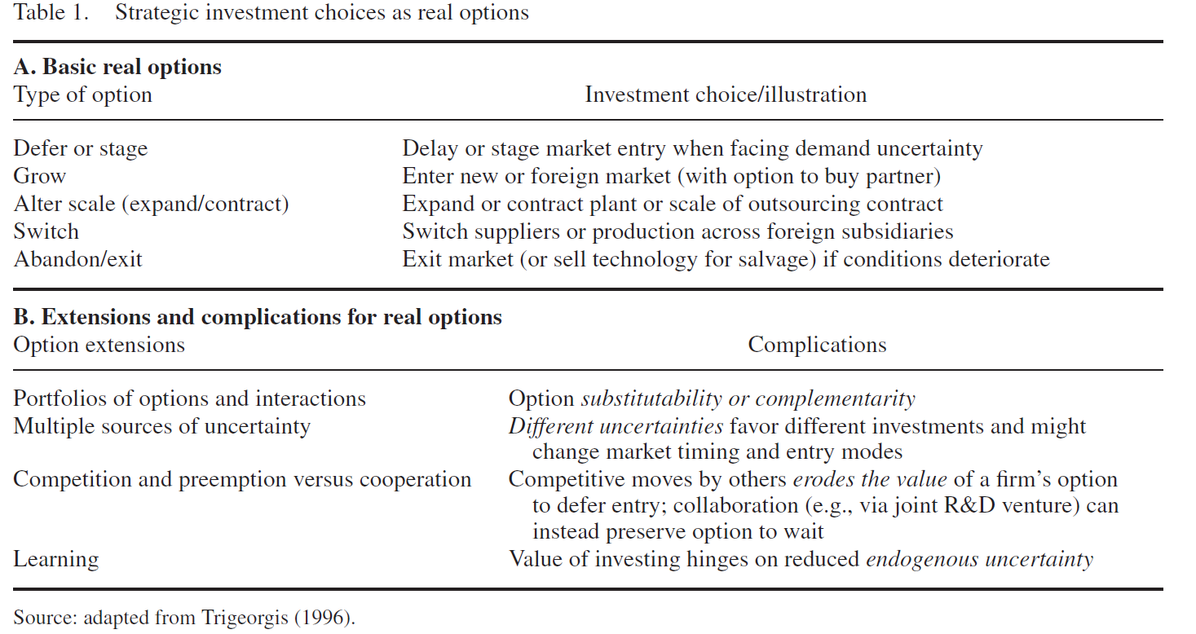
Taxonomy of Real Options

Slide 5
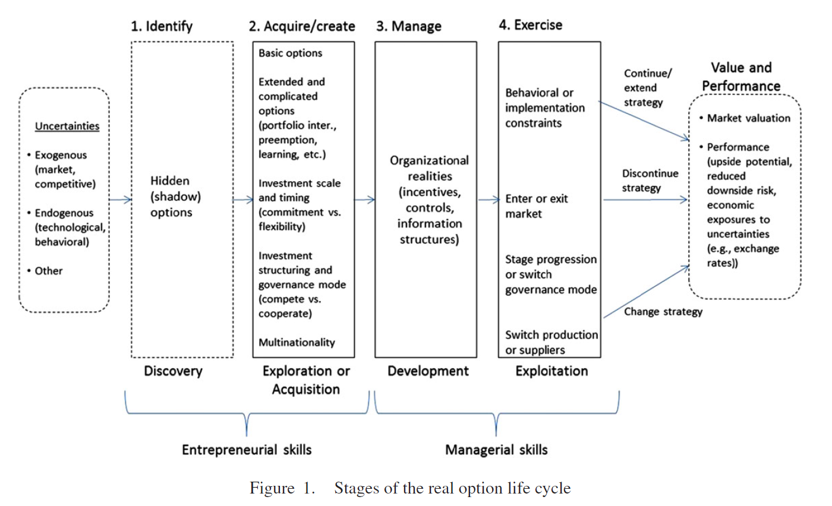
Stages of the real option life cycle
Less attention had been paid in the literature
This suggests the need to carry out research across these stages of the real option chain rather than in isolation or using one single approach to real options theory

Slide 6
Approaches to Real Options Decision Making
Approaches to Real Options Decision Making
Real options reasoning (ROR)
Real options valuation (ROV)
Behavioral perspectives (BP) on real options
1.ROR captures the formulation and testing of hypotheses based on verbal theorizing without the aid of analytical modeling.
2.Help structure decisions under uncertainty
Advantages:
1. Specific and transparent on key assumptions
2. Useful for developing propositions and comparative statics insights
Disadvantages:
1. Relies on restrictive assumptions that are not readily implementable in practice
2. Becomes removed from the practical relevance and organizational realities of interest to strategy scholars
1. Gives more attention to the human or behavioral nature of management and the constraints on the adaptive capabilities of organizations.
2. The domain of applicability of ROT is limited when necessary conditions such as decision flexibility and information accuracy are not met.
3. Managers are constrained by bounded rationality

Slide 7
A Taxonomy of Real Options Studies
There is a growing empirical literature on real options, and the strategic management field has made important contributions to the broader real options literature.
antecedents of strategic investments involving the purchase or exercise of various options as well as their valuation and performance
Classic trade-off between firm commitment and flexibility
Investment timing (e.g., market entry and exit timing)
The value of multinational operations
MNC as a coordinated network in response to environmental uncertainty
Strategy research is unique in addressing organizational realities, constraints, and implementation issues that can inform ROT
Market valuation challenges and firm performance measures

Slide 8
Real Options Theory and Strategy Issues
Firm heterogeneity & competitive advantage | The theory of the firm | Uncertainty, firms’ choices, and investment relation | The commitment VS flexibility dilemma | Trade-offs between competition and cooperation | Organization and governance mode choices
Real options both emerge from firm heterogeneity, and when pursued successfully, they enhance firm heterogeneity. Examine tensions of commitment vs flexibility and of cooperation vs competition in firms’ individual strategic investment decisions. | International flexibility and the dynamic advantages afforded by coordinated MNC networks as a source of value in a dynamic global environment. | Uncertainty and decision flexibility can be a source of value creation if real options are properly recognized, developed, and exercised | Uncertainty, asymmetric information, and learning can interact with the trade-offs between flexibility and commitment. | ROT combined with game theory can extend the notion of dynamic strategy to quantify potential shifts between competitive and cooperative modes in a dynamic environment over time. | Collaborative ventures serve as arrangements for dealing with uncertainty and partner competence development

Slide 9
Challenges for Real Options Research in Strategy
Real options and the foundations of strategy
How does ROT contribute to addressing the key issues of strategy
Differences and potential integration with other strategy theories (IO, TCE, and RBV)
Key driver: uncertainty
Role of management and organizational realities
Consider human characteristics and cognitive biases, managerial incentives
Integration among real options approaches
Future research designs
Greater focus on the business unit and the individual project level of analysis
Reconsider the unit of analysis in real options studies
More fine-grained empirical work

Slide 10
Conclusion
Develop a framework for organizing extant research on ROT along several dimensions: (1) types of real options, (2) stages of the real option chain, (3) types of strategic decisions, (4) core strategy trade-offs or dilemmas cast in a two-dimensional space (i.e., flexibility versus commitment and cooperation versus competition), and (5) various approaches to real options research (i.e., real option reasoning, real option modeling, and behavioral perspective).
Examine key challenges for real options research in strategic management
There exists a pressing need to integrate related managerial disciplines and perspectives into an integrated organizational approach.

